Slide 1
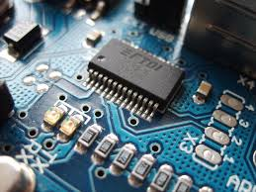
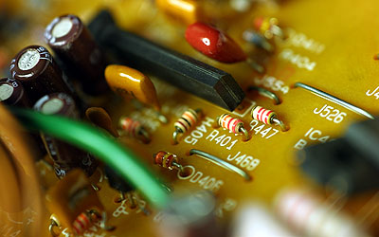

CO2015 Basic Electronic Circuit Components

Slide 2
Course Introduction
Objectives
Knowledge about structure and operation of electronic devices
An understanding of how devices such as semiconductor diodes and transistors are modeled and how the models are used in the analysis of useful circuits.
The capability to analyze and simulate behavior and performance of application electronic circuit
Grading
Midterm Exam: 20%
Final Exam: 50%
Labs: 20%
Presentations: 10%

Slide 3
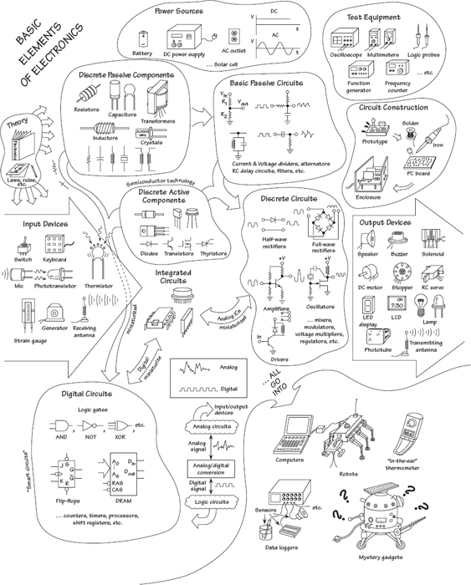
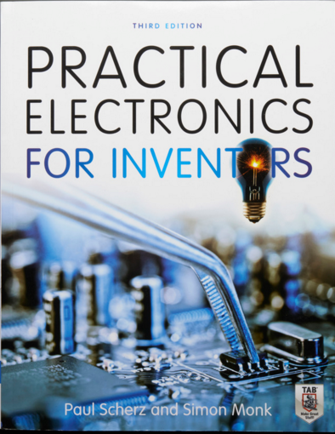

Slide 4
Basic Electronic Circuit Components
Wires, Cables, and Connectors
Batteries
Switches
Resistors
LED (Light Emitted Diode)

Slide 5
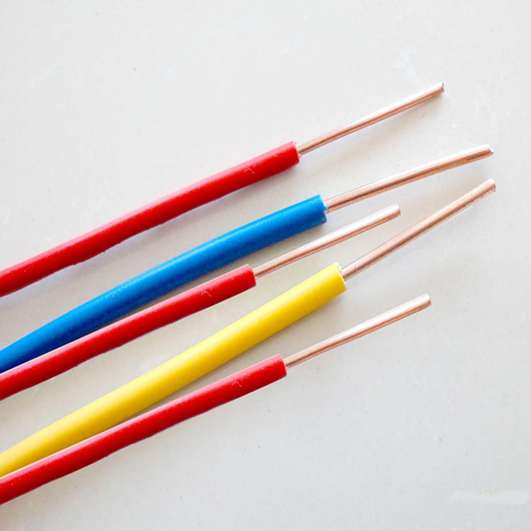
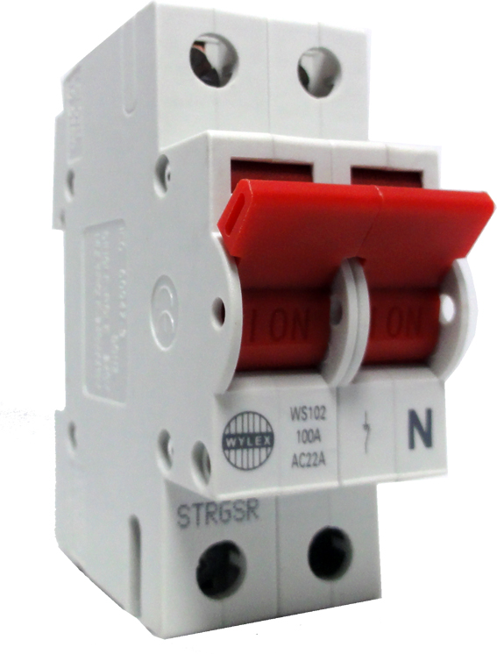
Solid Core Wires
Strong
High current

Slide 6
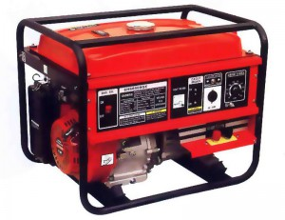
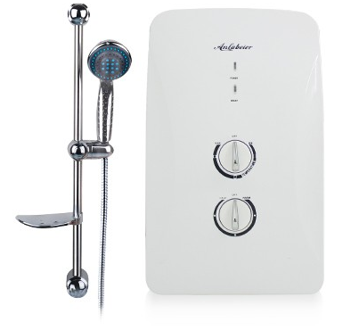
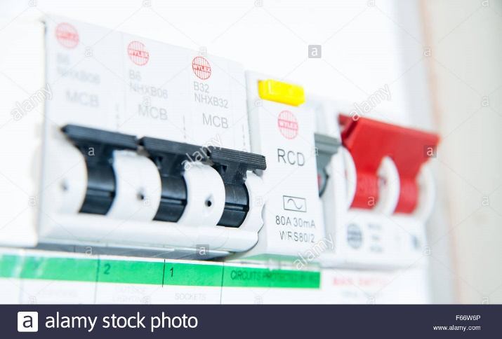
Solid Core Applications

Slide 7
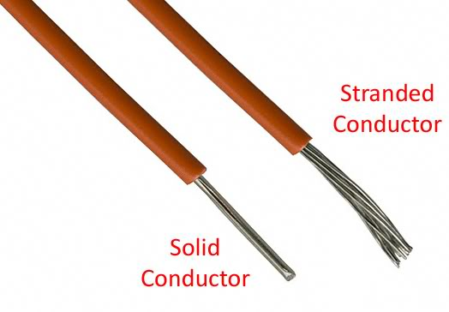
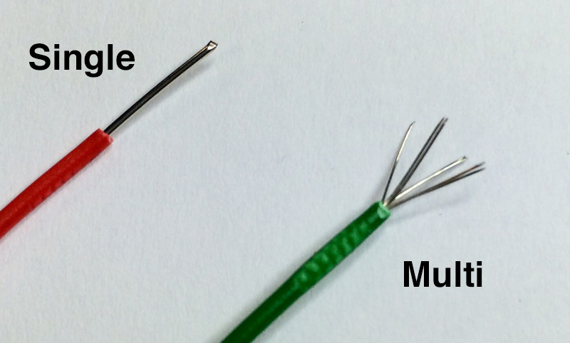
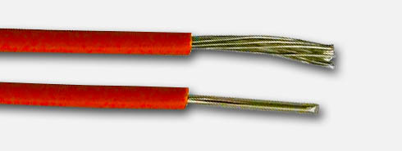
Stranded Wires (Multicore Wires)
Soft
Smaller current
Easy to Draw

Slide 8

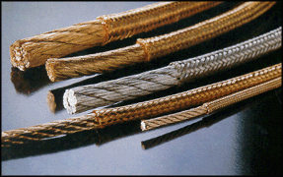
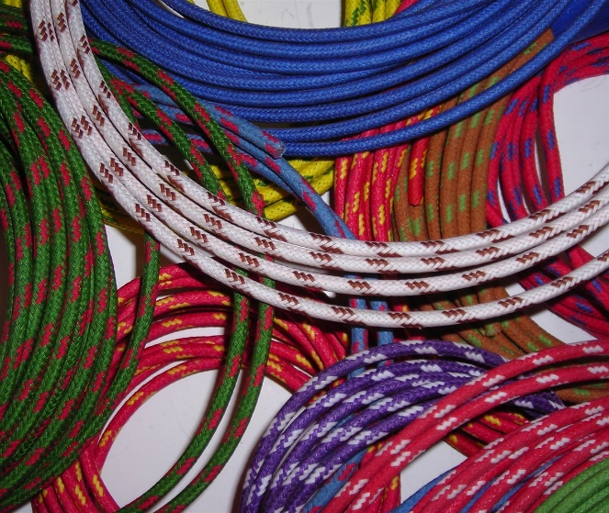
Braided Wires
Soft and High current

Slide 9
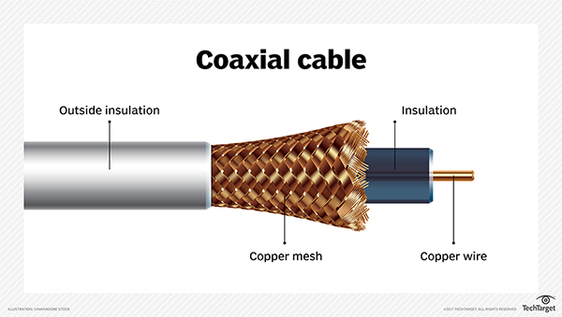
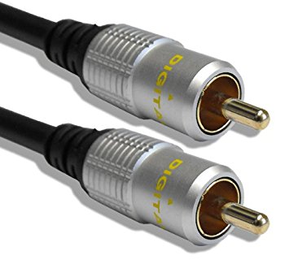
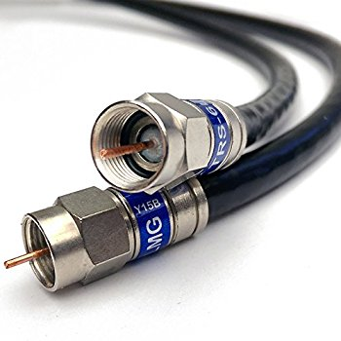

Coaxial Cables
High speed communication systems

Slide 10
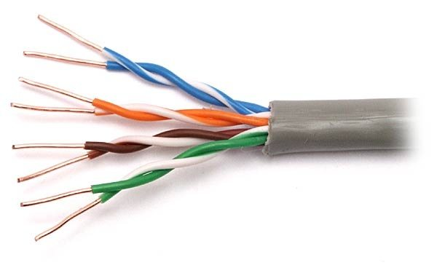
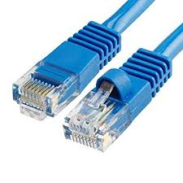
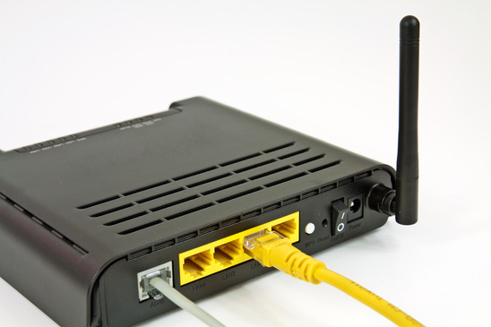
Twisted Pair Cables
Pulse noise avoidance
ADSL Modem (RJ45)

Slide 11
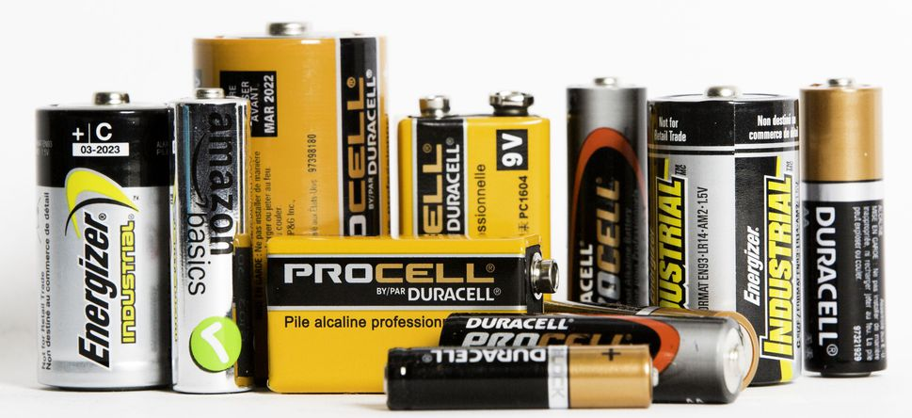
Battery
The most popular storage device

Slide 12
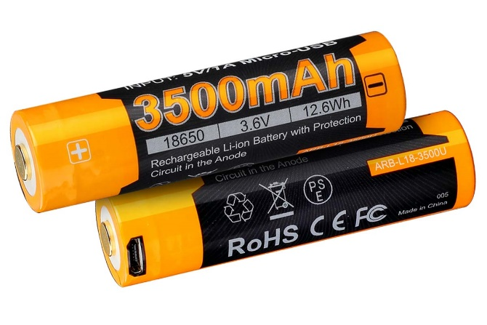

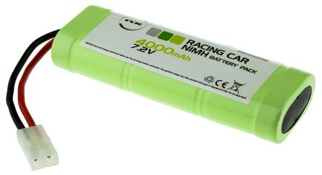
Rechargeable Batteries
Battery capacity: 3500mAh

Slide 13
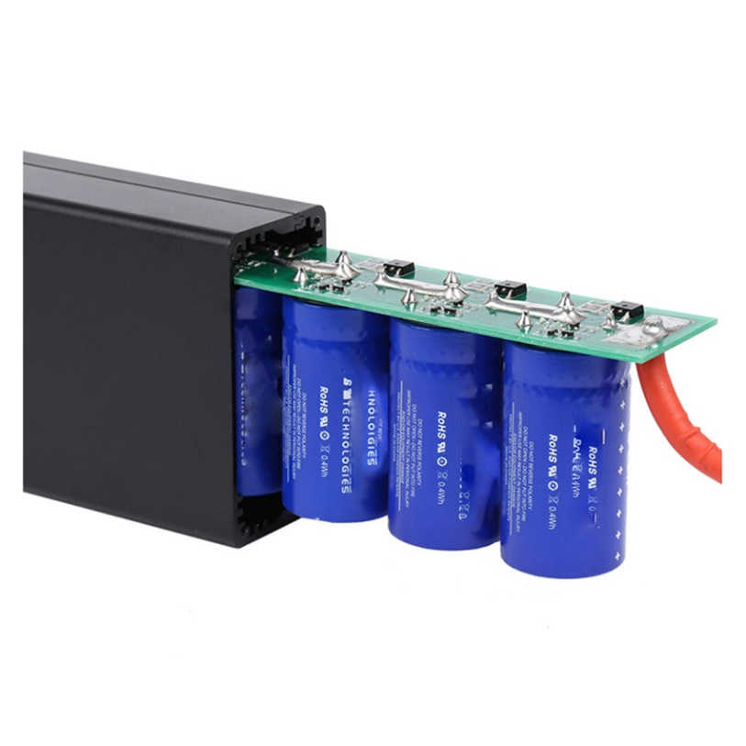
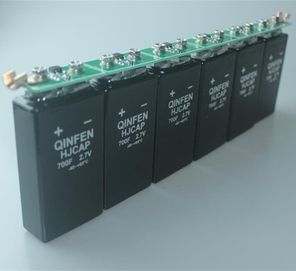
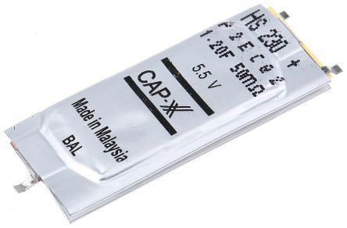
Super Capacitors

Slide 14
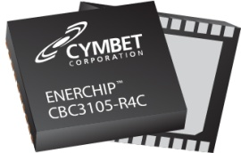
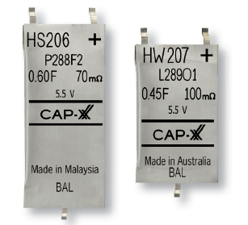
Rechargeable Batteries vs Super Capacitor
500 recharge cycles
Difficult to estimate the state of charge
Low leakage current
[Cymbet ]
500 000 recharge cycles
Easy to estimate the state of charge
High leakage current
[CapXX]

Slide 15
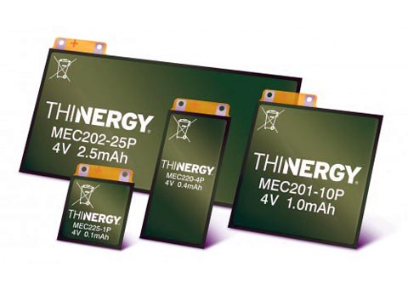
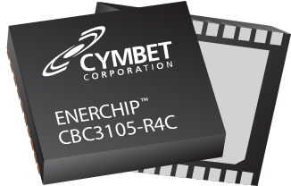
New Generation of Batteries
IC Rechargeable Batteries
Hybrid Batteries (Batteries + Capacitors)

Slide 16
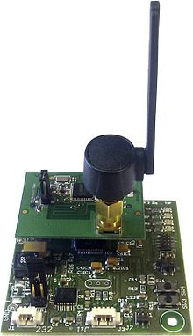
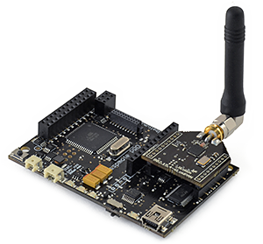
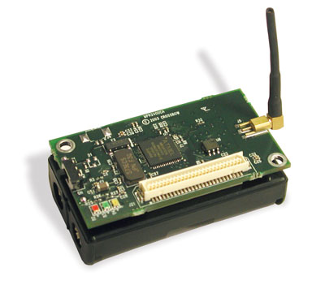

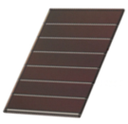

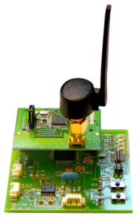
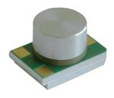

Internet of Things Platforms
PowWow
MicaZ
Wasp Mote
Harvesters
MESC
WSN node
OutCap
DC-DC
Converter
V_{dd}
Solar
Energy
Adapter
Energy
Flow
Controller
Thermal
StoreCap
V_{S}
ADC
Energy flow
Signal control

Slide 17
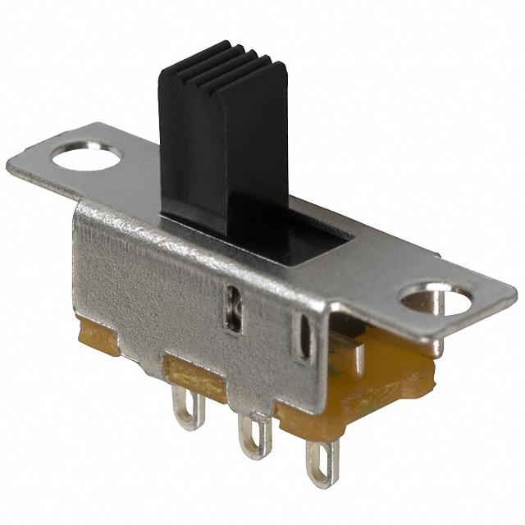
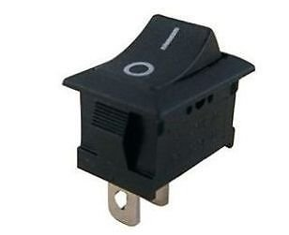
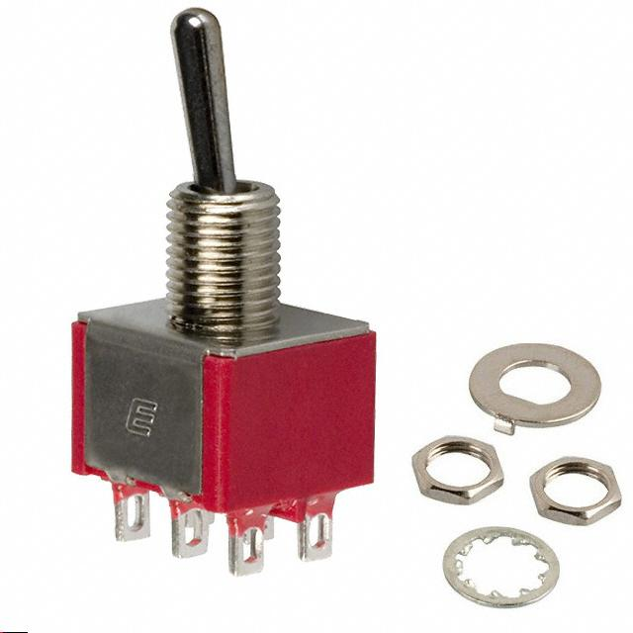
Switch
A switch is a mechanical device that interrupts or diverts electric current flow within a circuit

Slide 18
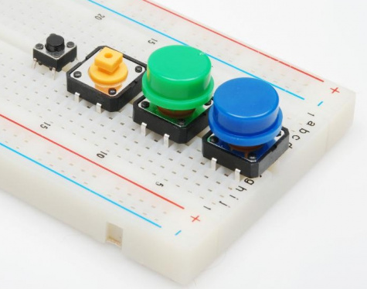
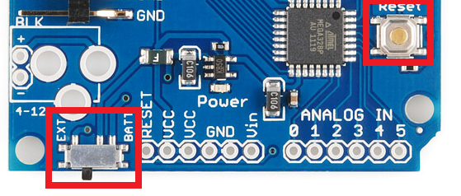
Mounting Style
A switch always comes down to either surface mount (SMD) or through-hole (PTH).

Slide 19
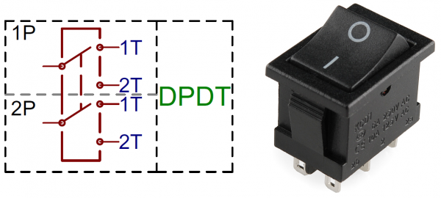
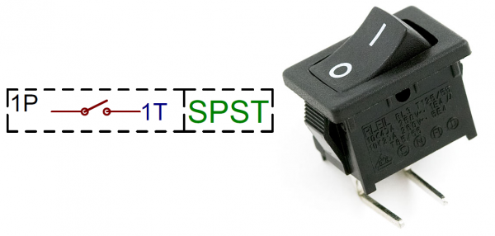
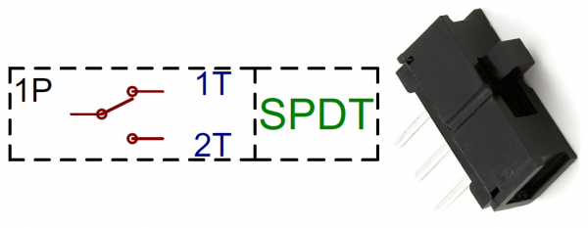
Poles and Throws, Open and Closed
Single-pole, Single-throw (SPST)
Single-pole, Double-throw (SPDT)
Double-pole, Double-throw (DPDT)

Slide 20
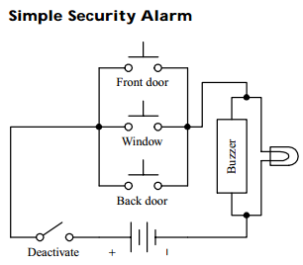
Switch Applications (1)
Here’s a simple home security alarm that’s triggered into action (buzzer and light go on) when one of the normally open switches is closed. Magnetic reed switches work particularly well in such applications.

Slide 21
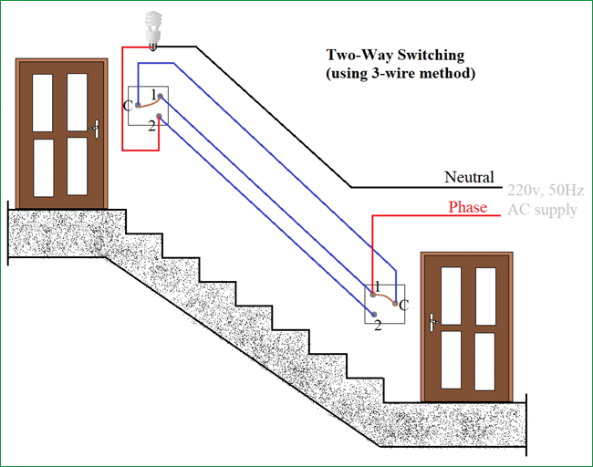
Switch Applications (2)
Here’s a switch network that allows an individual to turn a light on or off from either of two locations. This setup is frequently used in household wiring applications.

Slide 22
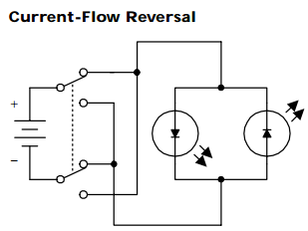
Switch Application (3)
A DPDT switch, shown here, can be used to reverse the direction of current flow. When the switch is thrown up, current will flow throw the left light-emitting diode (LED). When the switch is thrown down, current will flow throw the right LED. (LEDs only allow current to flow in one direction.)
SW₁
LED₁
LED₂
SW₂

Slide 23
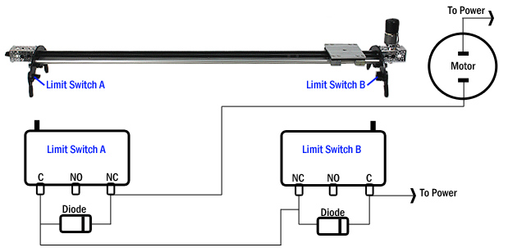
Switch Application (4)

Slide 24
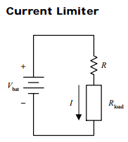
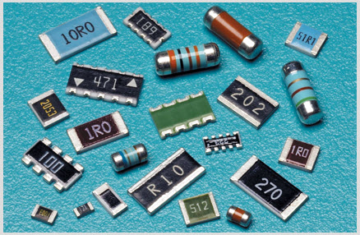

Resistors

Slide 25

Current Limiter
Key point for color LED TIVI

Slide 26

Understanding Resistor Labels

Slide 27

Examples

Slide 28

Examples

Slide 29

Examples

Slide 30


Parallel Resistance Calculator

Slide 31

Ohm Law
Analyze the circuit

Slide 32
Answer
3V = 300I₁ – 200I₂
6V = 200I₁ – 500I₂

Slide 33

Midterm Exam BK172

Slide 34
Midterm Exam BK172
An LED which has the characteristics shown in this graph is to be used in the circuit below in which both VS and R can be varied. For this LED the switch on voltage (VD) is 1.7 volt which produces a current of 10 mA at which point the LED will just glow dimly. Let us say that the LED operates brightly at 40 mA, but will fail if the current exceeds 90 mA for too long.
Initially the power supply is set at Vs = 6V. What value is required for the resistor so that the LED operates at 40 mA?
If a current of 20 mA is flowing and the resistor is 200 Ohm, what is the supply voltage?
Find the minimum value of the resistor that could be used without damaging the LED

Slide 35




Variable Resistors
Special kinds of variable resistors include
Potentiometers;
Rheostats; and
Trimmers.
Potentiometers and rheostats are essentially the same thing, but rheostats are used specifically for high-power ac electricity, whereas potentiometers typically are used with lower-level dc electricity. Both potentiometers and rheostats are designed for frequent adjustment.
Trimmers, on the other hand, are miniature potentiometers that are adjusted infrequently and usually come with pins that can be inserted into printed-circuit boards.

Slide 36


Photo-Resistors and Thermistors

Slide 37




Light Emitted Diode (LED)

Slide 38


Optical Touch LED Matrix

Slide 39


LED and Resistor Calculation

Slide 40


LED and Resistor Calculation

Slide 41


LED Applications

